Slide 1
Recursion
Mushtari Sadia

Slide 2
Definition
A programming technique where a function calls itself
in programming, goal is to NOT have infinite recursion
must have 1 or more base cases that are easy to solve
def f(n):
return f(n-1)
def f(n):
if n==1:
return
return f(n-1)

Slide 3
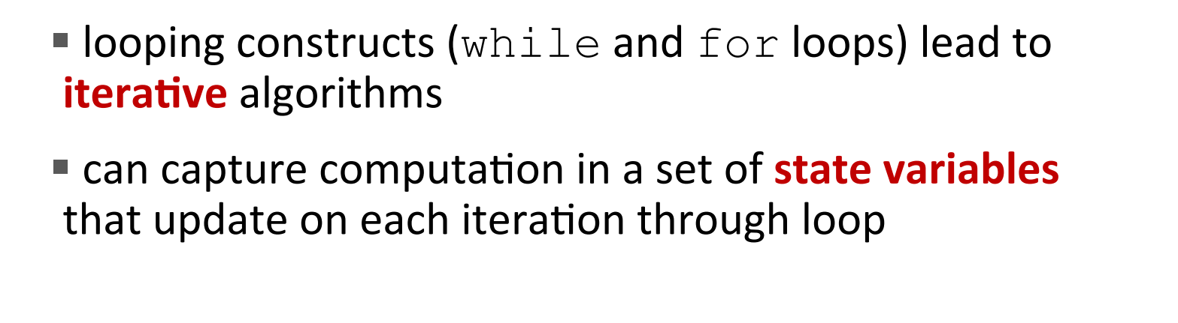
Iterative Algorithms So Far

Slide 4
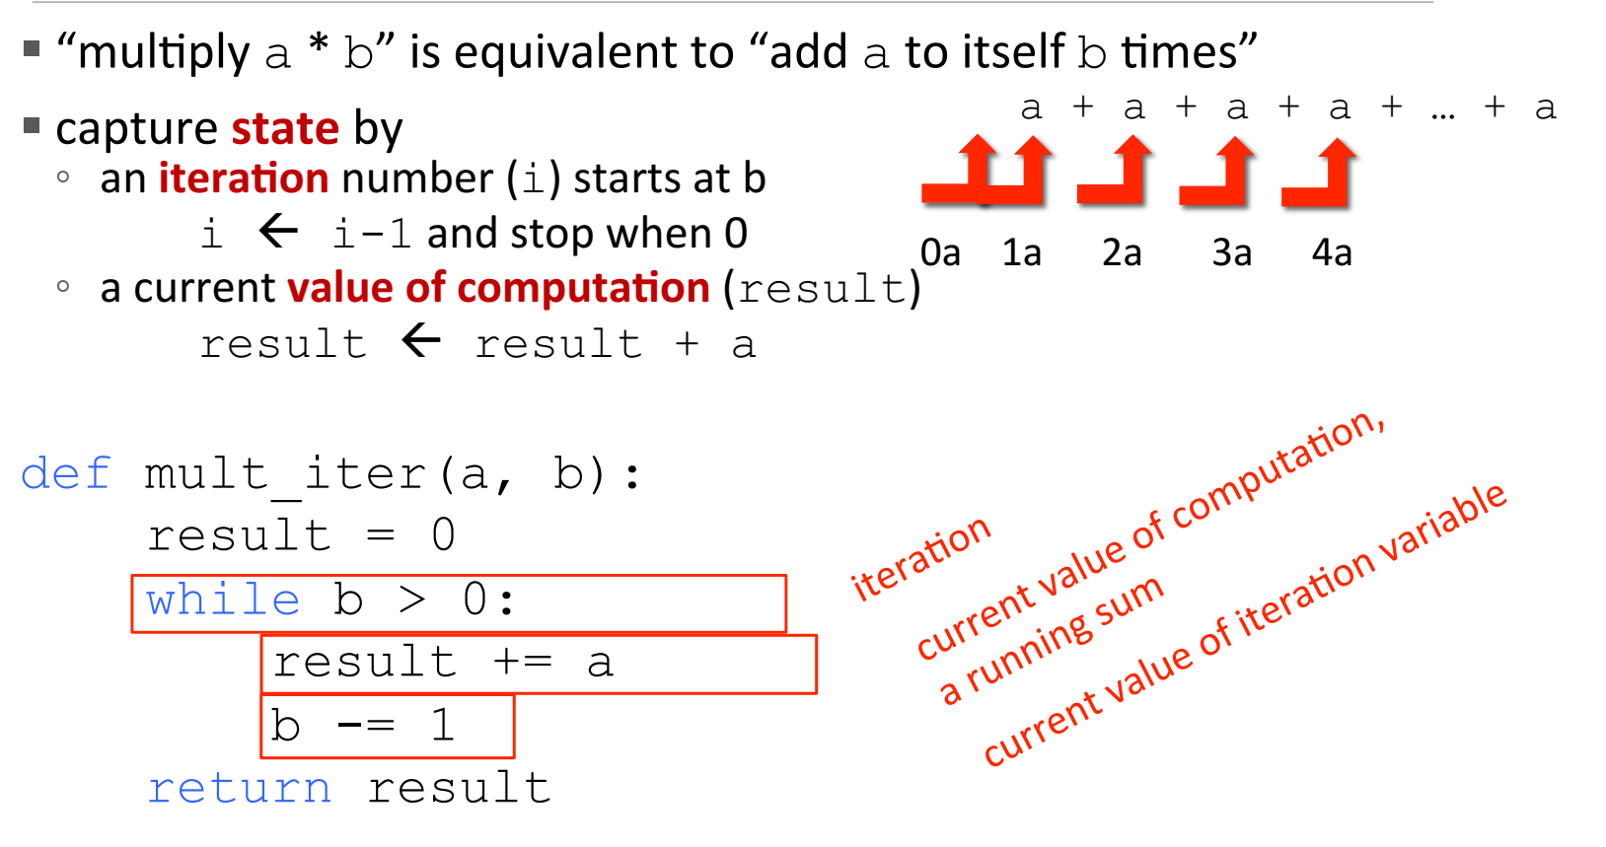
Multiplication - Iterative Solution

Slide 5
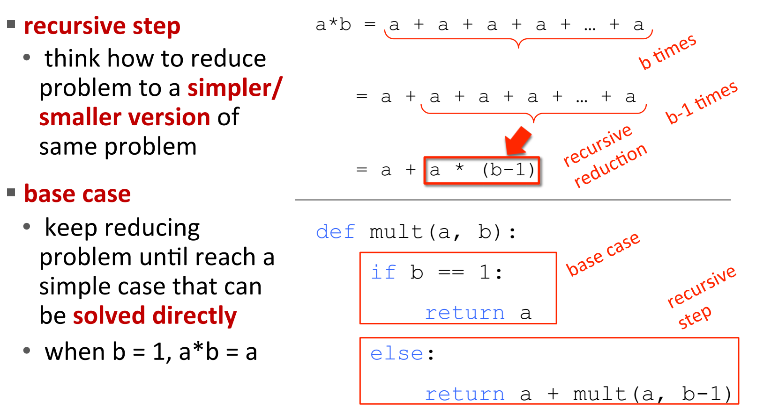
Multiplication - Recursive Solution

Slide 6
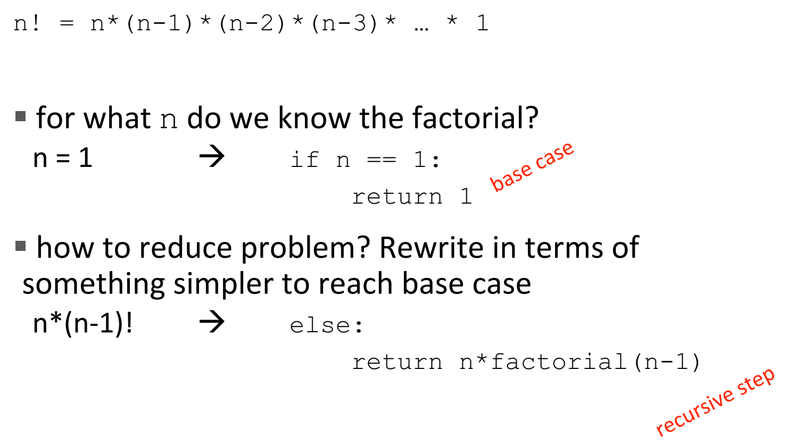
Factorial - Recursive Solution

Slide 7
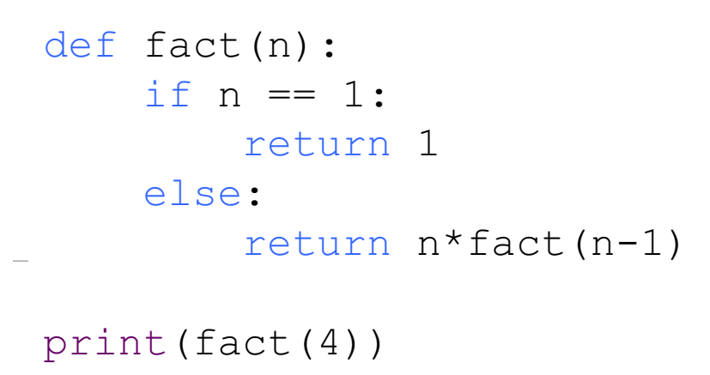
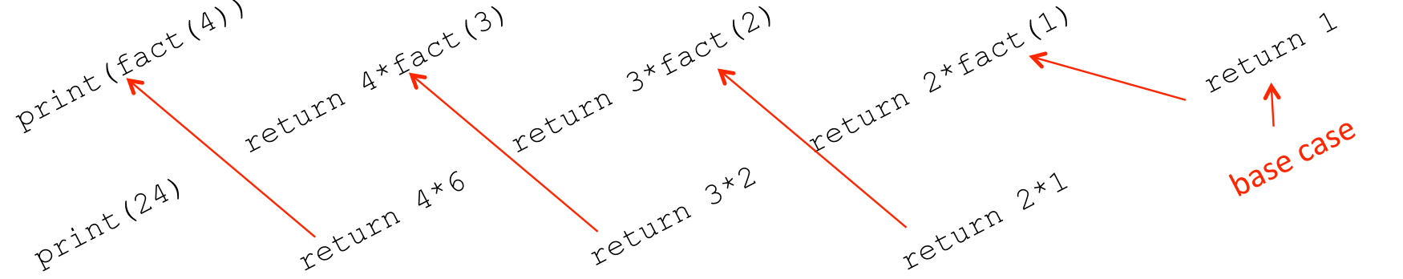
Factorial - Recursive Solution

Slide 8
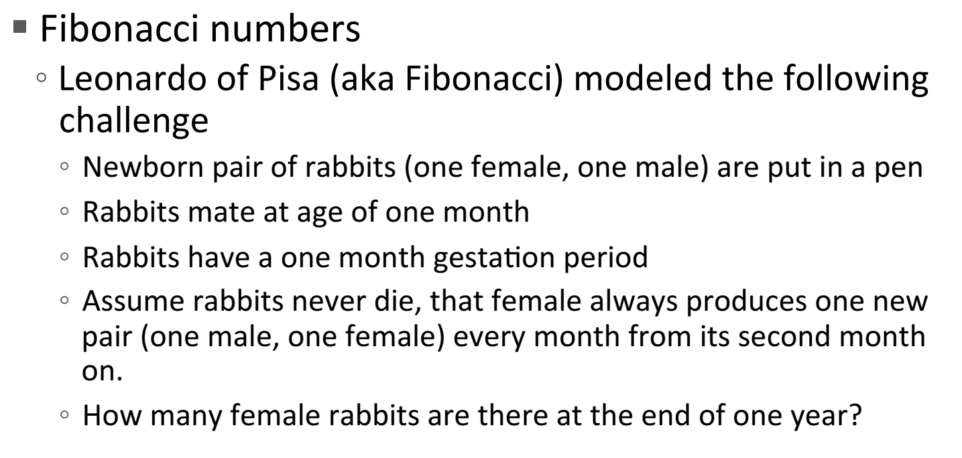
Multiple Recursive Calls

Slide 9
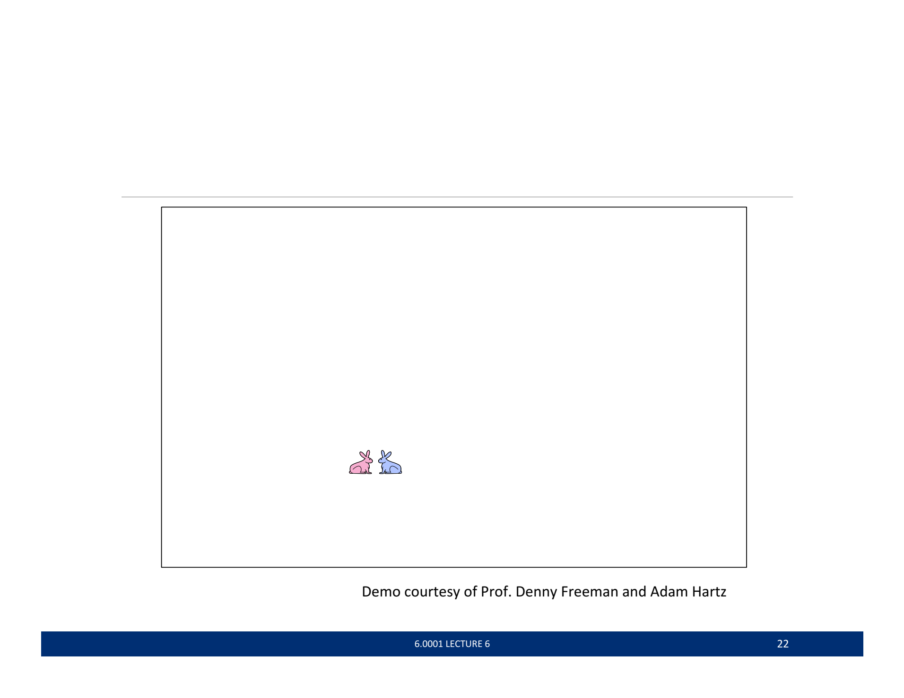
Multiple Recursive Calls
Month | Count
1 | 1
2 | 1

Slide 10
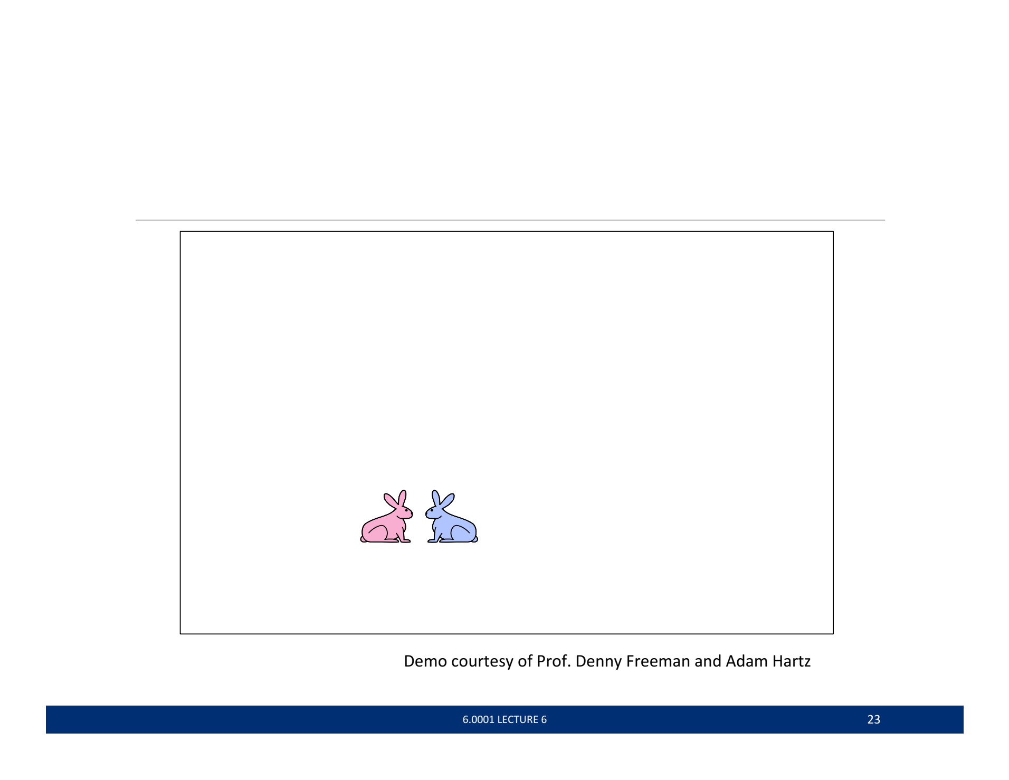
Multiple Recursive Calls
Month | Count
1 | 1
2 | 1

Slide 11
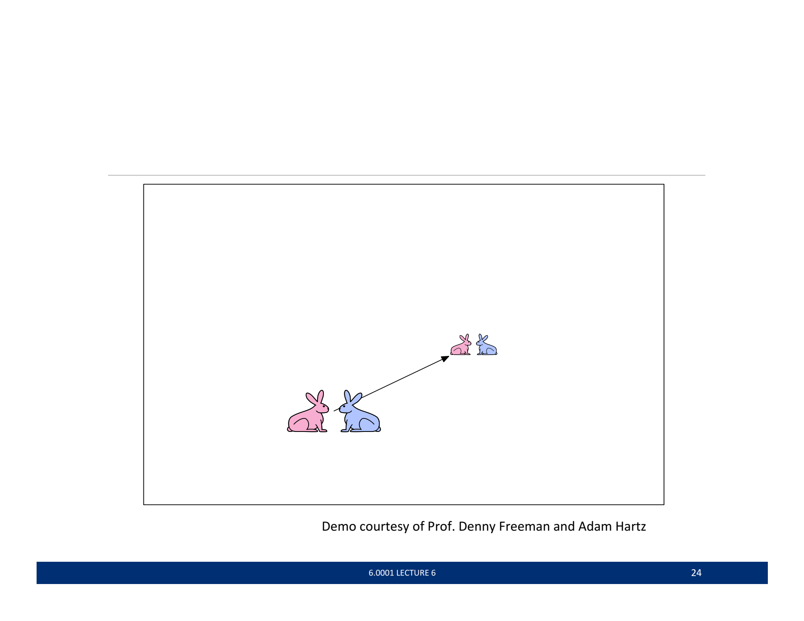
Multiple Recursive Calls
Month | Count
1 | 1
2 | 1
3 | 2

Slide 12
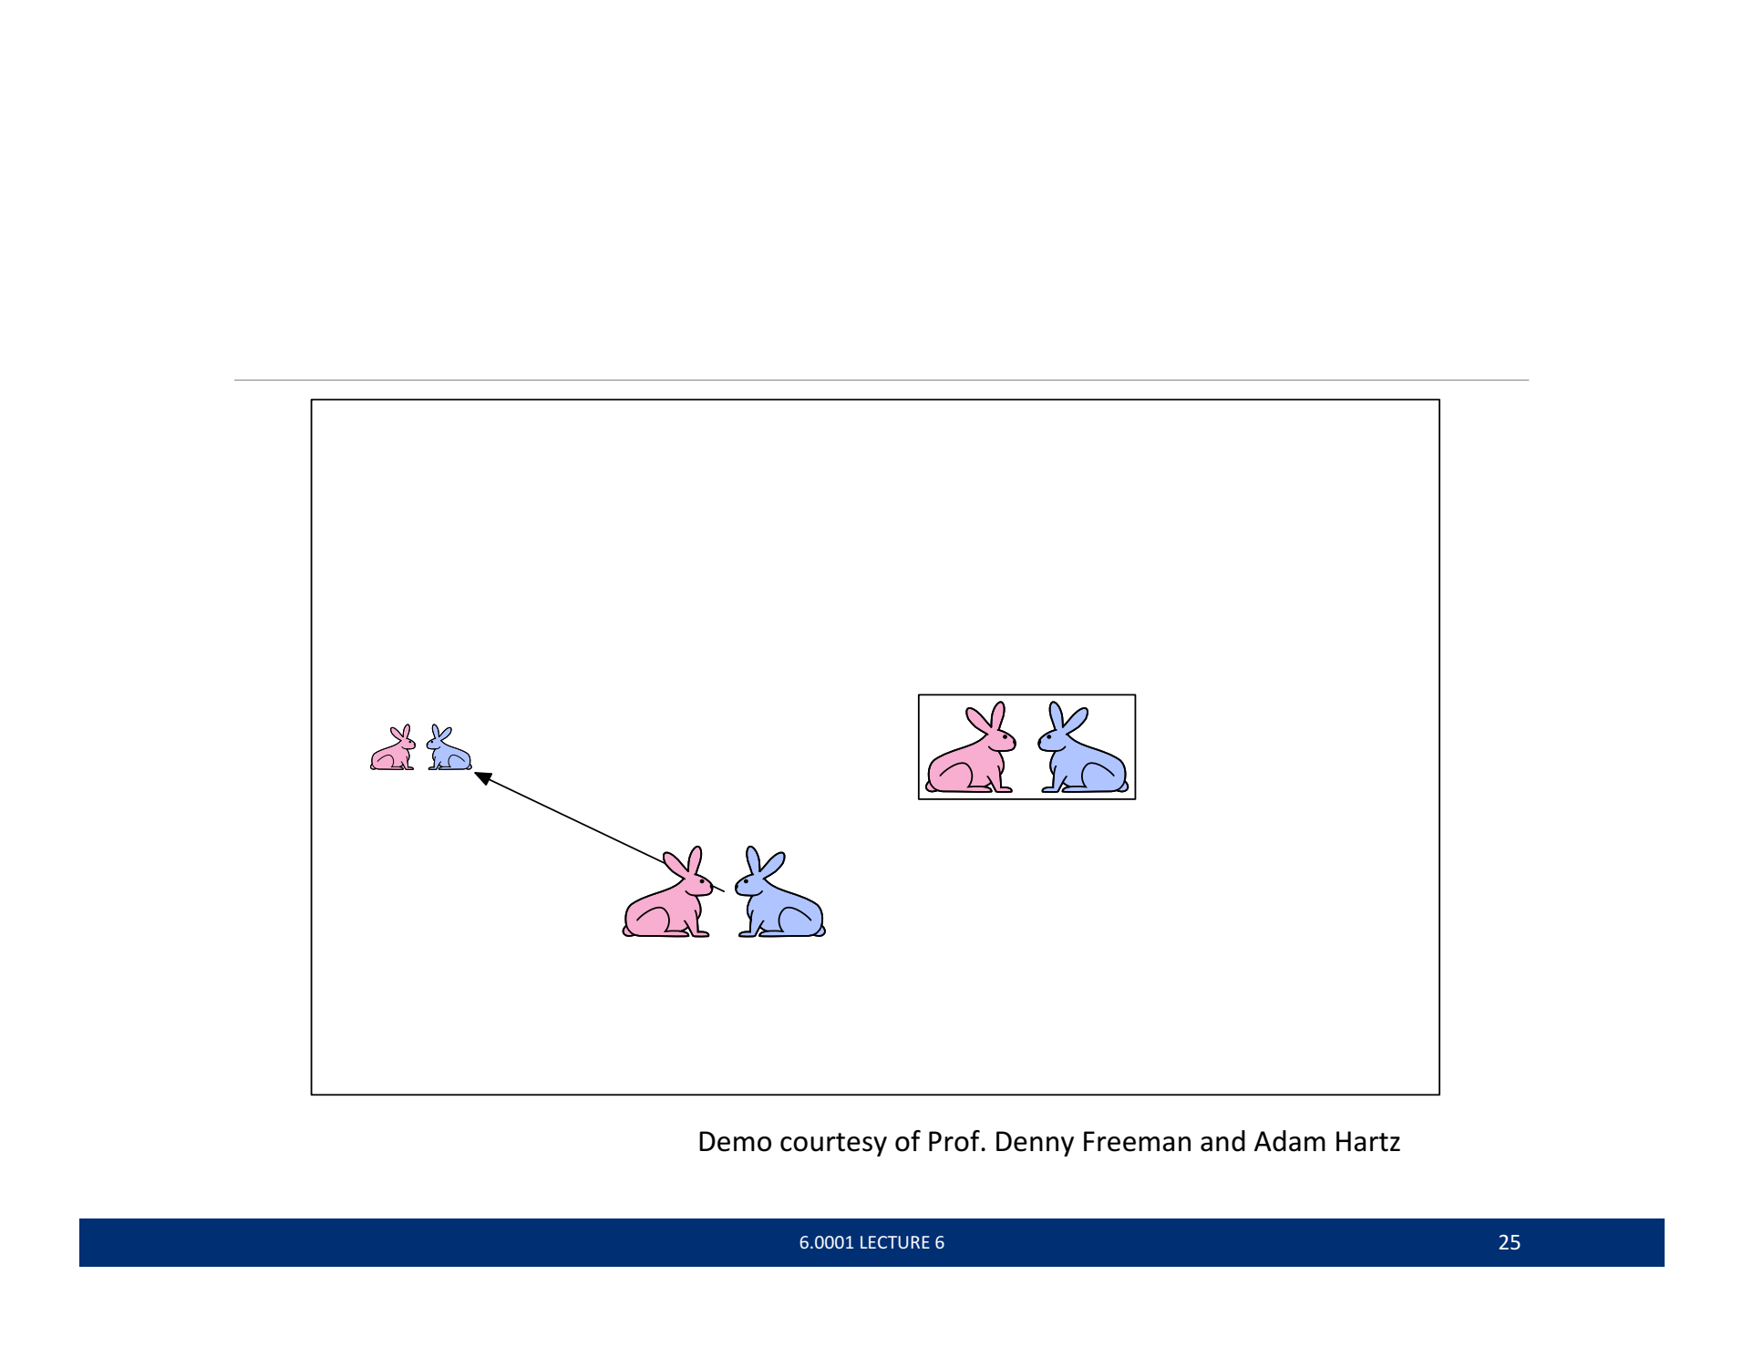
Multiple Recursive Calls
Month | Count
1 | 1
2 | 1
3 | 2
4 | 3

Slide 13
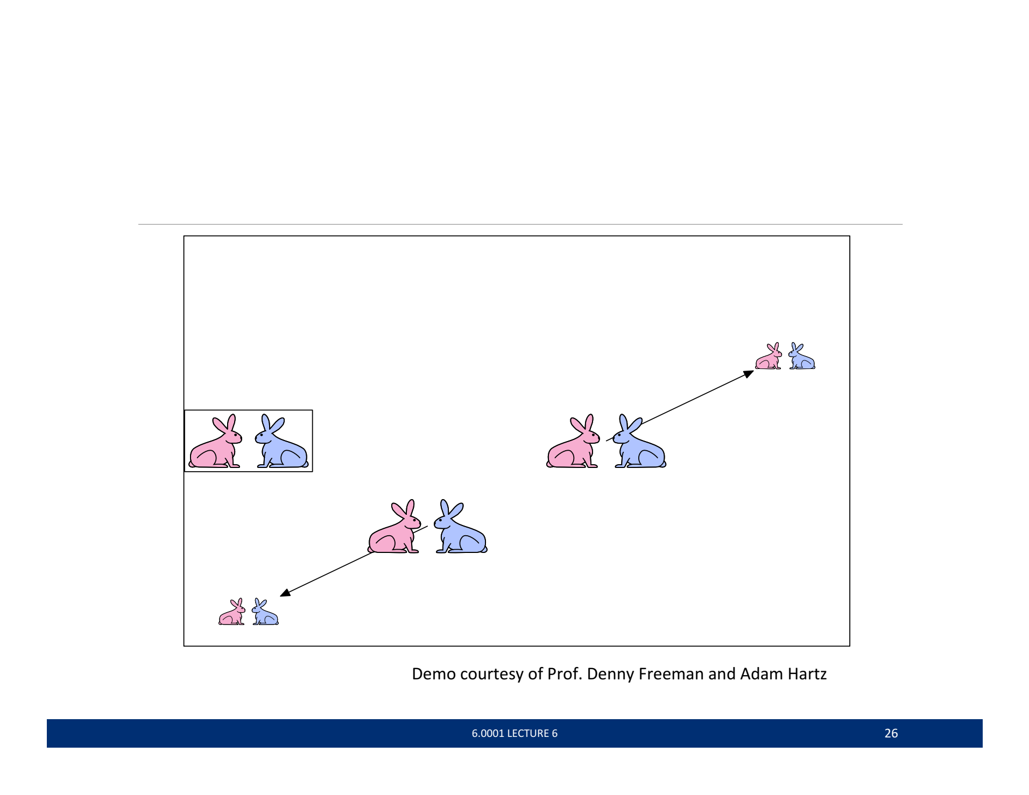
Multiple Recursive Calls
Month | Count
1 | 1
2 | 1
3 | 2
4 | 3
5 | 5

Slide 14
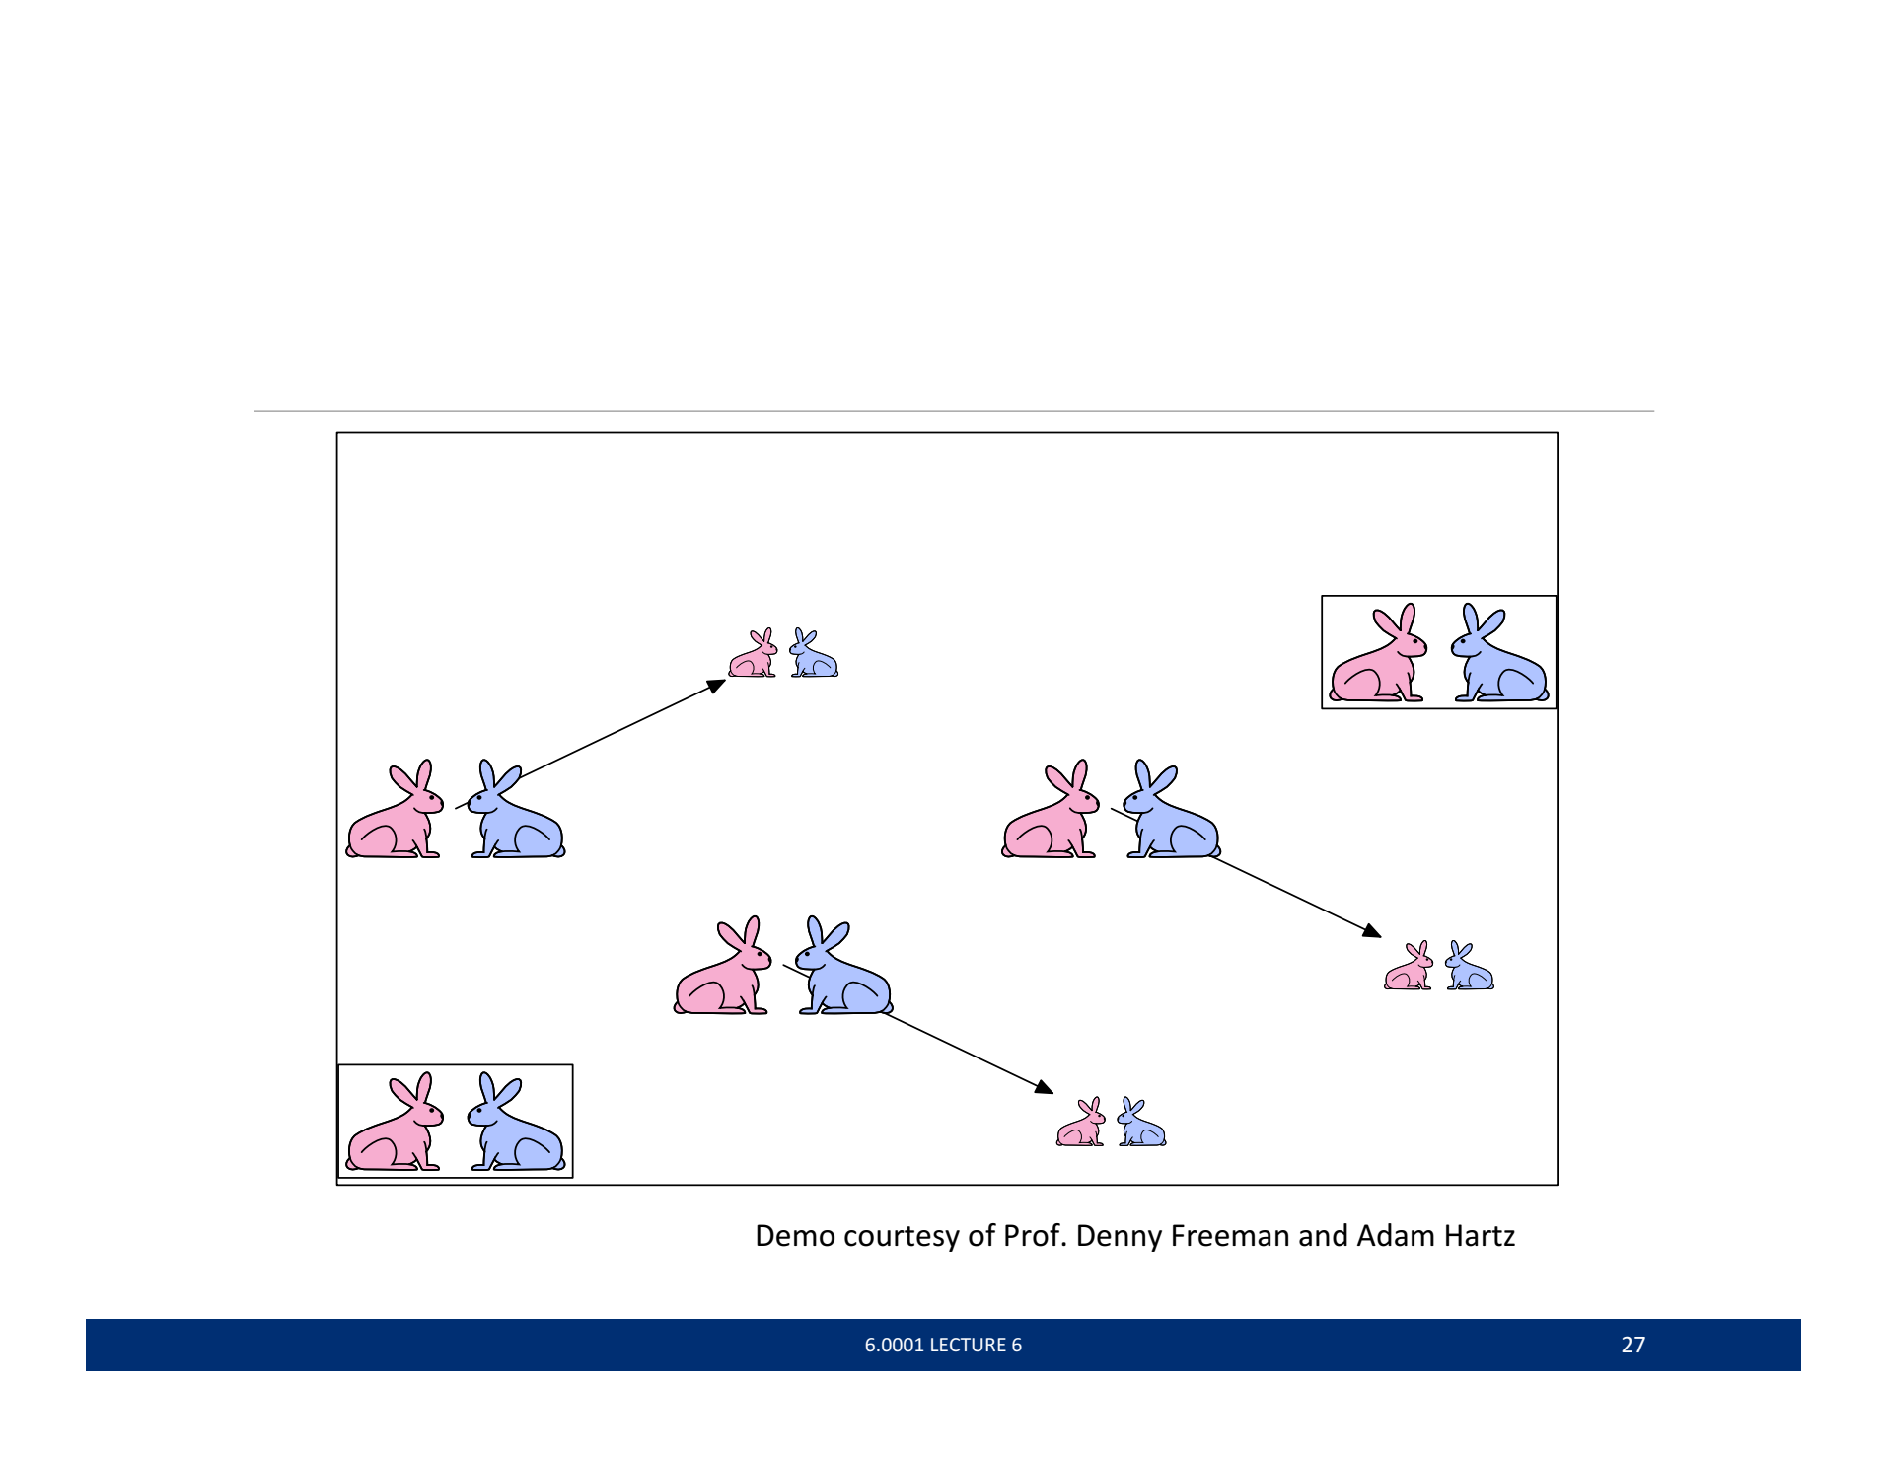
Multiple Recursive Calls
Month | Count
1 | 1
2 | 1
3 | 2
4 | 3
5 | 5
6 | 8

Slide 15
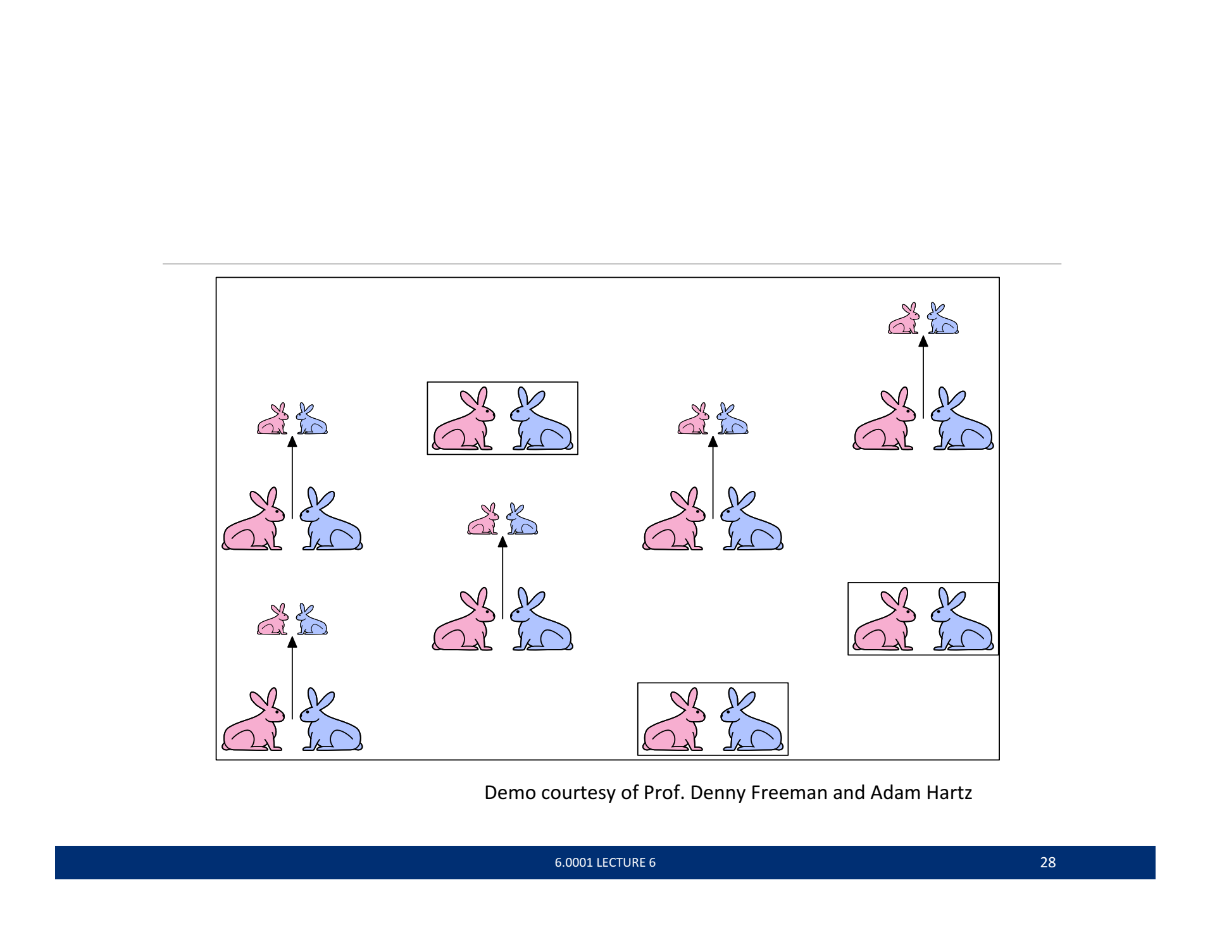
Multiple Recursive Calls
Month | Count
1 | 1
2 | 1
3 | 2
4 | 3
5 | 5
6 | 8
7 | 13

Slide 16
Fibonacci Numbers
Month | Count
1 | 1
2 | 1
3 | 2
4 | 3
5 | 5
6 | 8
7 | 13
f(n) = f(n-1) + f(n-2)

Slide 17
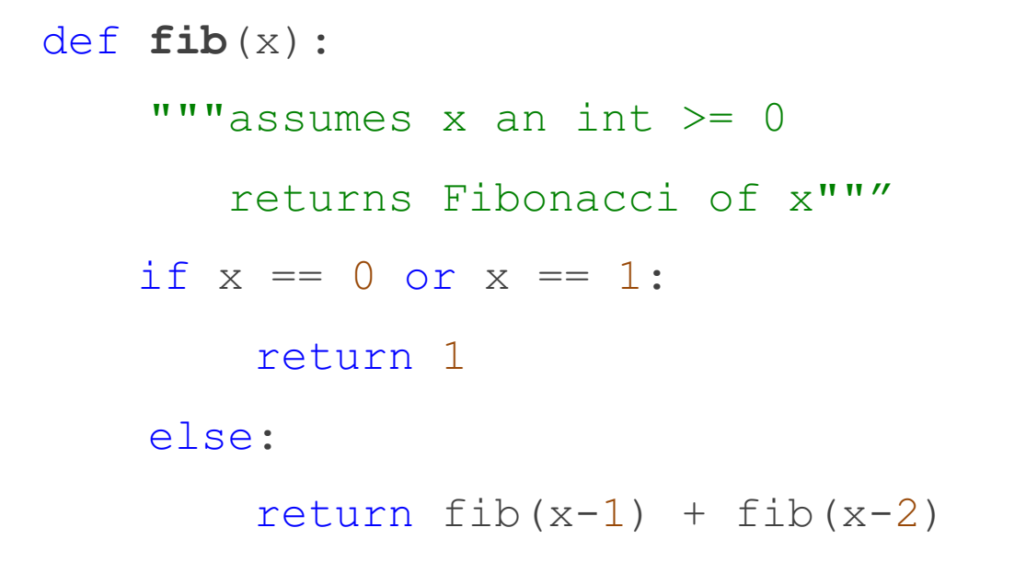
Fibonacci Numbers

Slide 18
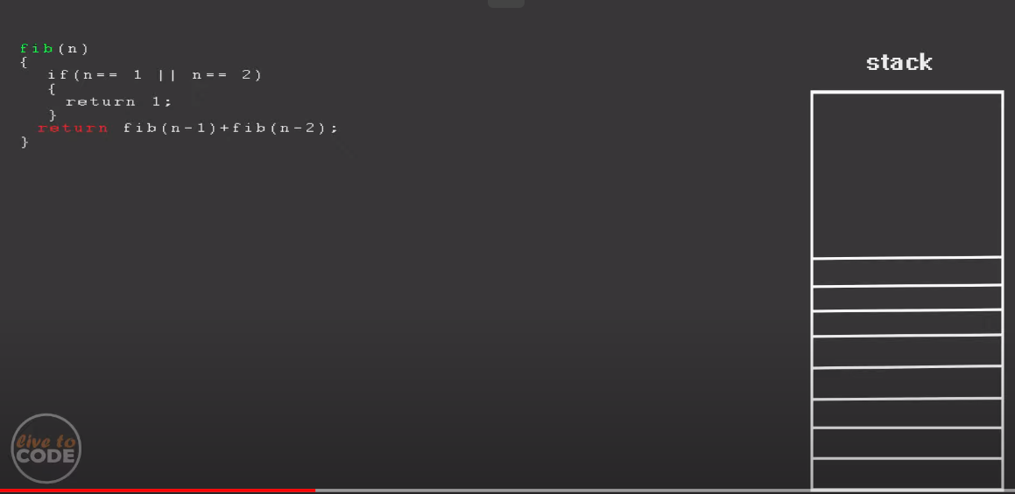

Slide 19
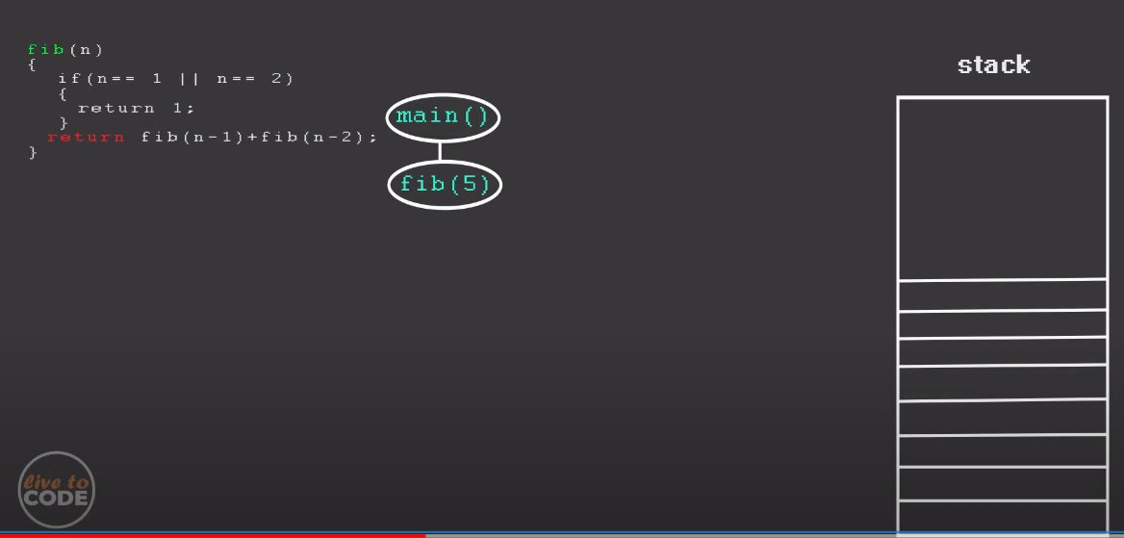

Slide 20
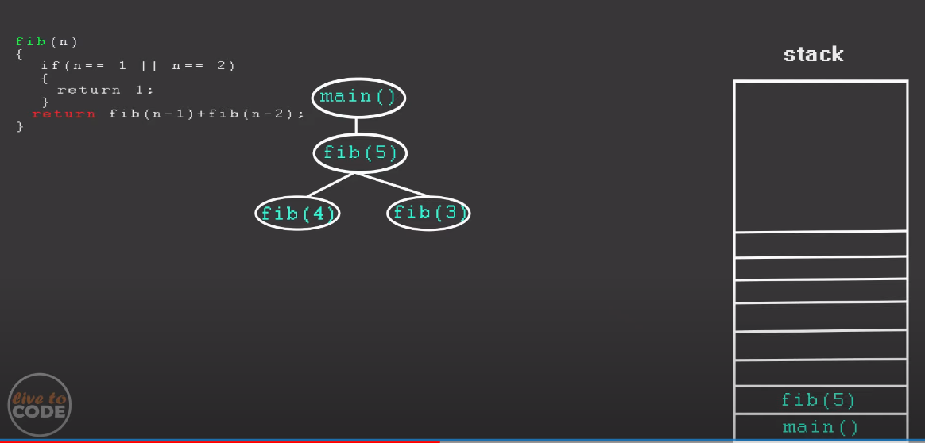

Slide 21
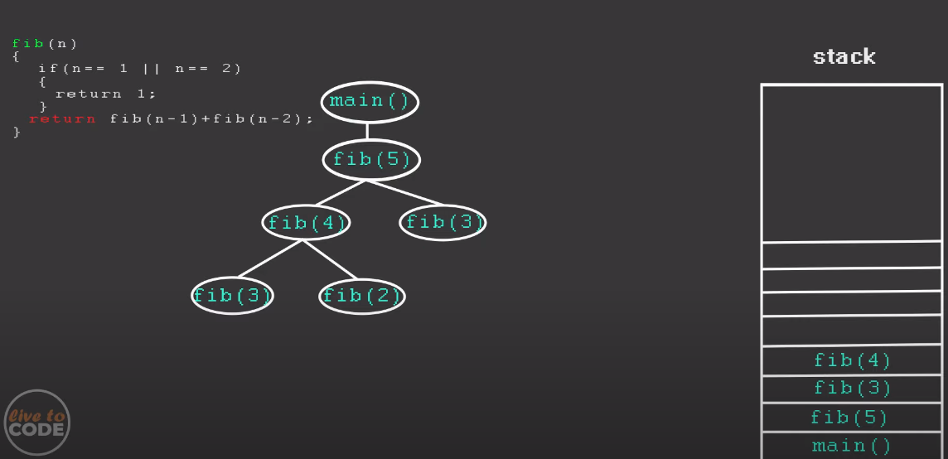

Slide 22
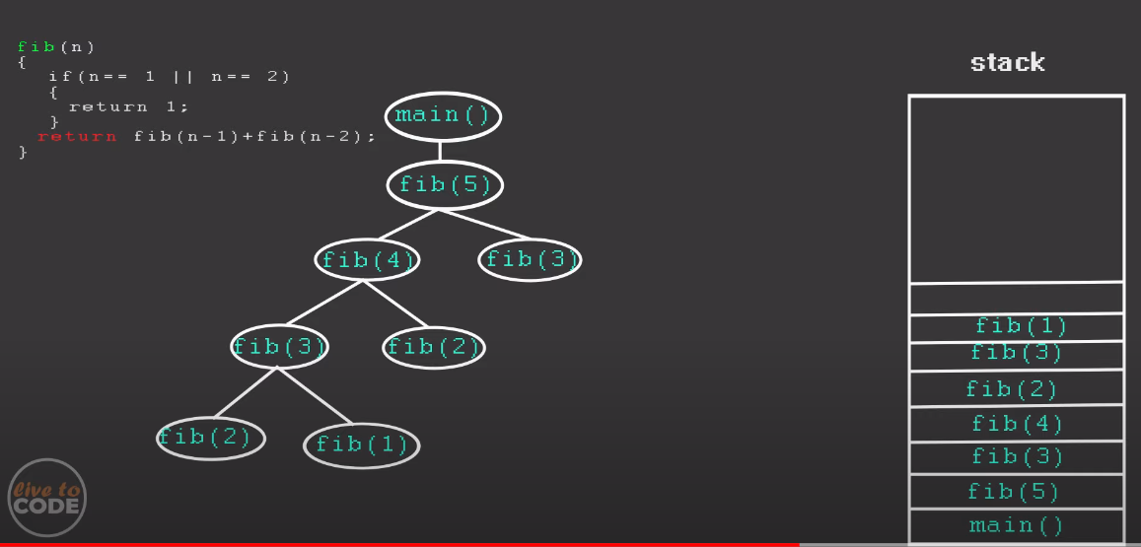

Slide 23
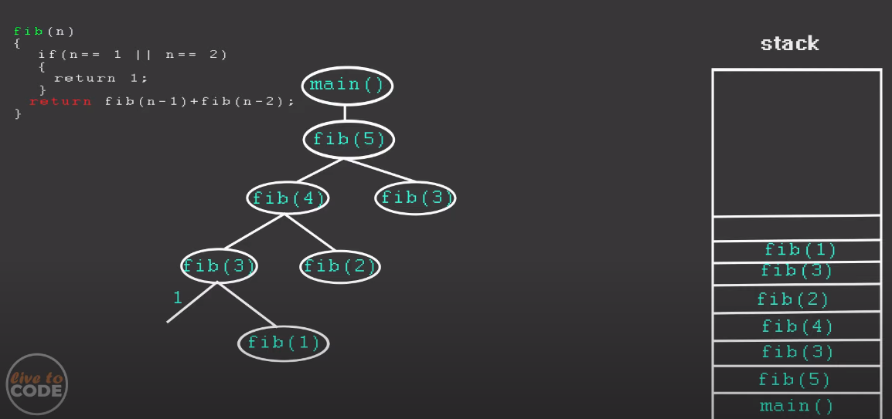

Slide 24
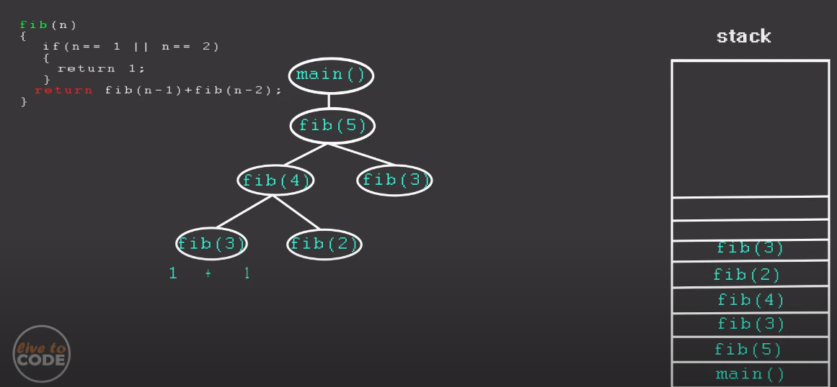

Slide 25
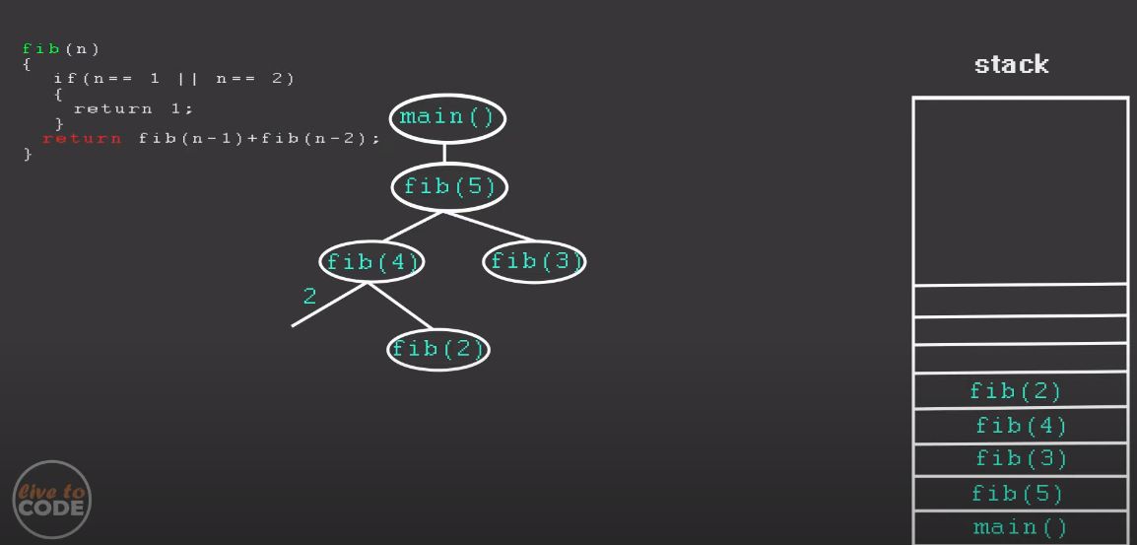

Slide 26
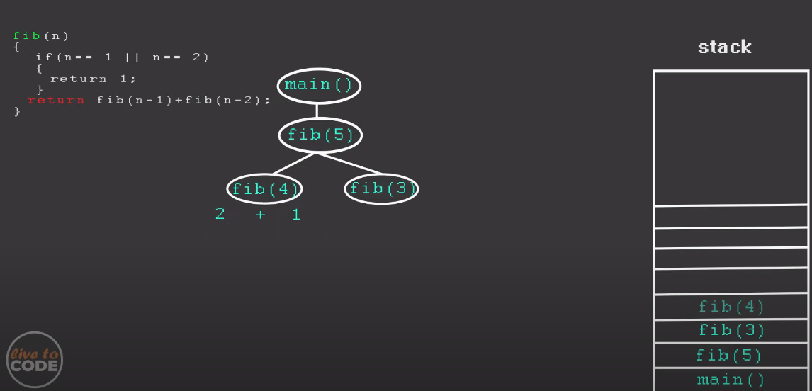

Slide 27
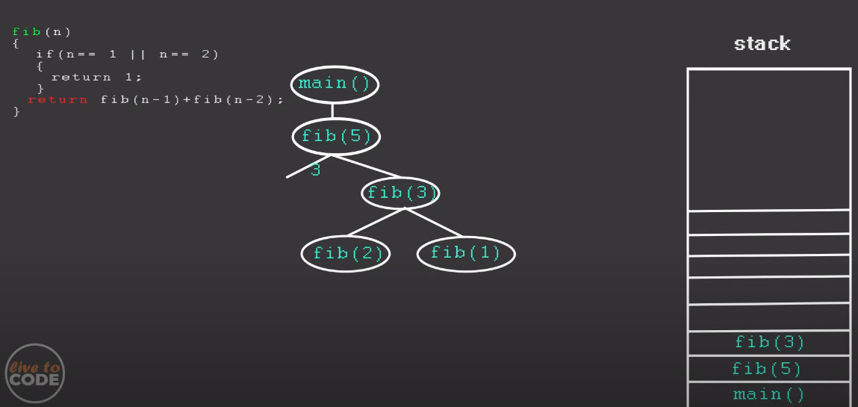

Slide 28
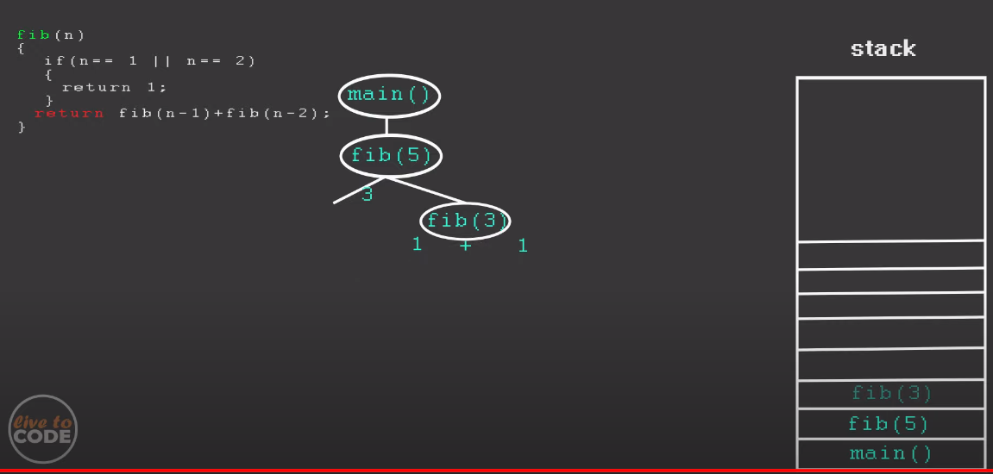

Slide 29
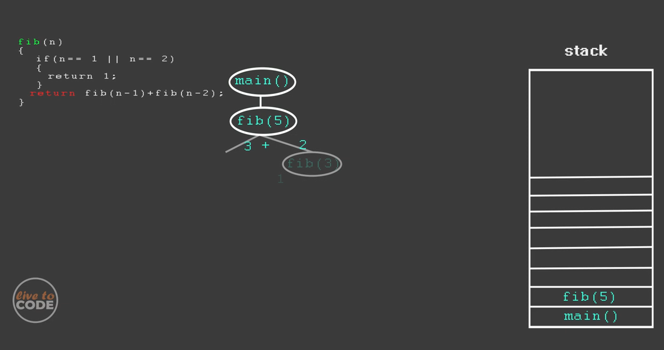

Slide 30
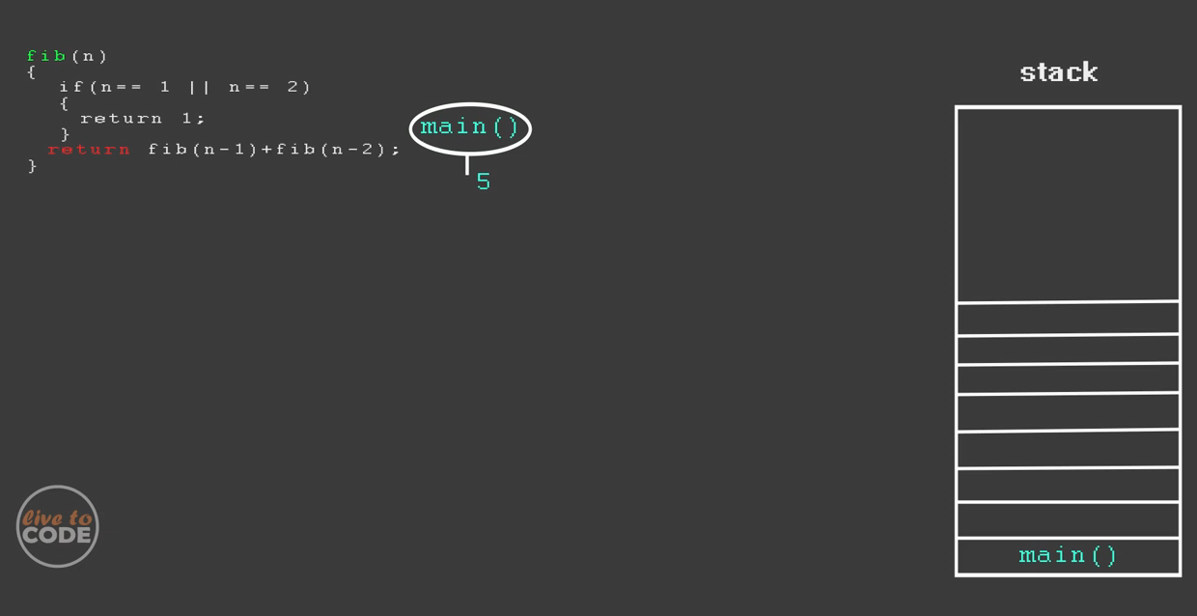

Slide 31
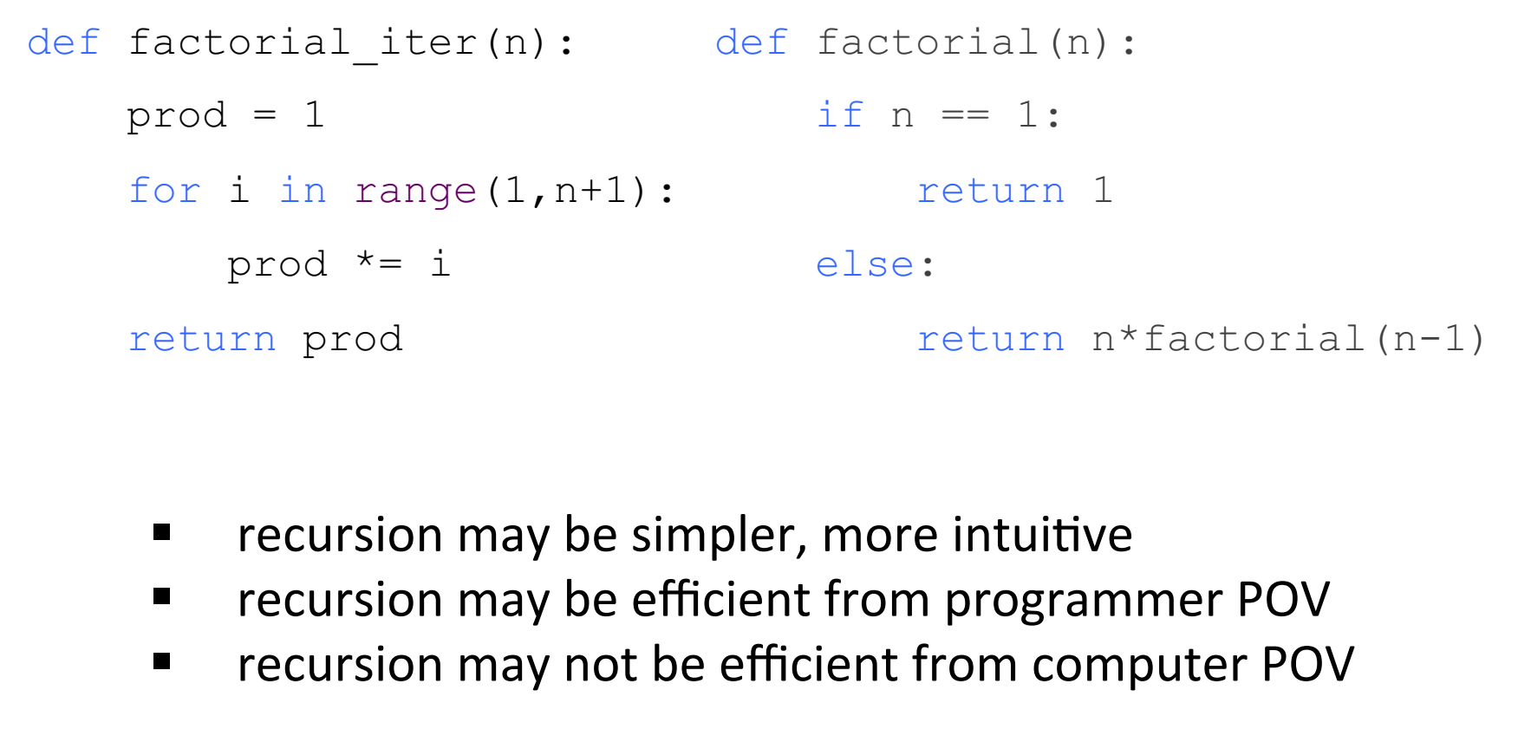
Iteration Vs Recursion
Stack overflow error!

Slide 32
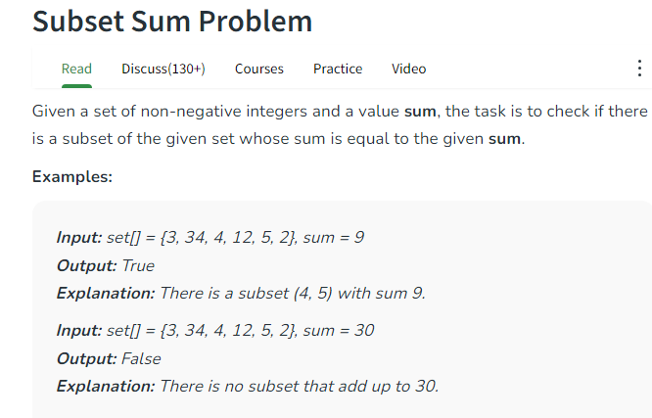

Slide 33
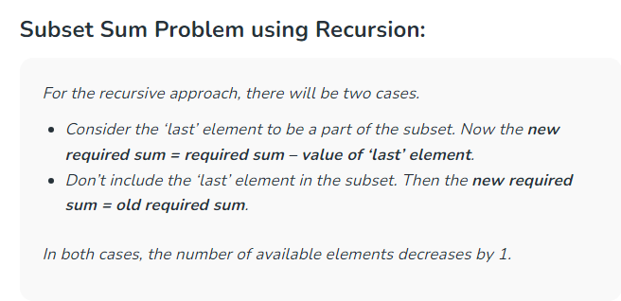

Slide 34
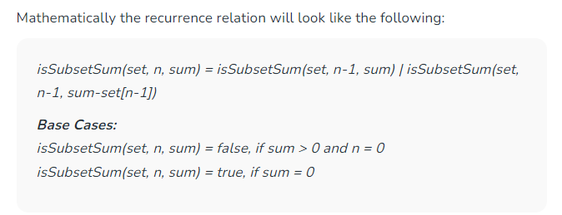

Slide 35
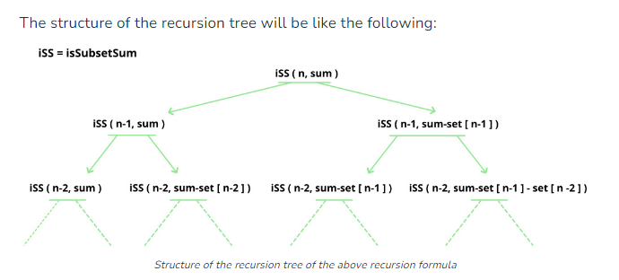

Slide 36
